Slide 1
Skill Check
for algorithm programmer selection

Slide 2
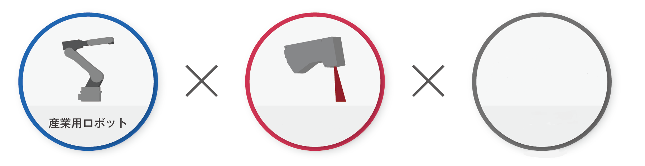
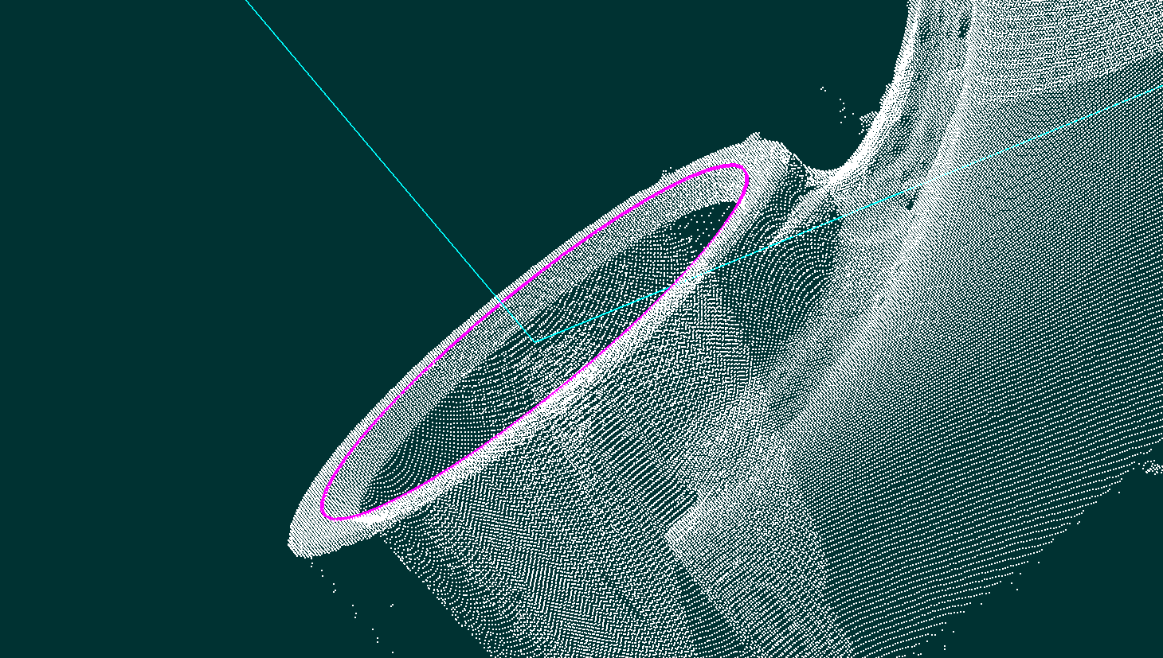

Developers to Create algorithms
Robotics
3D Scanner
Software
Algorithms
- LINKWIZ is a company that operates in evolving applications of robotics.
- We provide new solutions for factories that have adopted robotic automation.
- We are looking for developers to help create algorithms that analyze and compare shapes and features from 3D point cloud data obtained from a scanner attached to a robot.

Slide 3
-Challenge- C++ programing to identify holes in 3D point cloud data
Attached is a sample of point cloud data. (HoleDetectionTestData.txt)
The task is to identify the radii, centers and normals of the two holes.
You may use any compiler you wish, but we would recommend Microsoft Visual C++, available free with any Visual Studio Community edition.
Any standard of the C++ language is acceptable, and any open-source point cloud processing library (eg. PCL) may be used.
In addition, we would also like you to send us the source code for review. There is no need to send us any library files.

Slide 4
Skill Check Procedure
Submission Deadline: 2days (48hours)
It is recommended that you submit even if no solution has been found.
How quickly you submit your solution (output) will also be taken into account for the evaluation.
Please send your source code to: tech_primary@linkwiz.co.jp
LINKWIZ is looking forward to see you soon.

